Slide 1
Experience the Power of LTI2!
Charles Severance
IMS Global Learning Consortium
University of Michigan
Sakai PMC Chair
http://etherpad.ctools.org/p/mmwcon

Slide 2

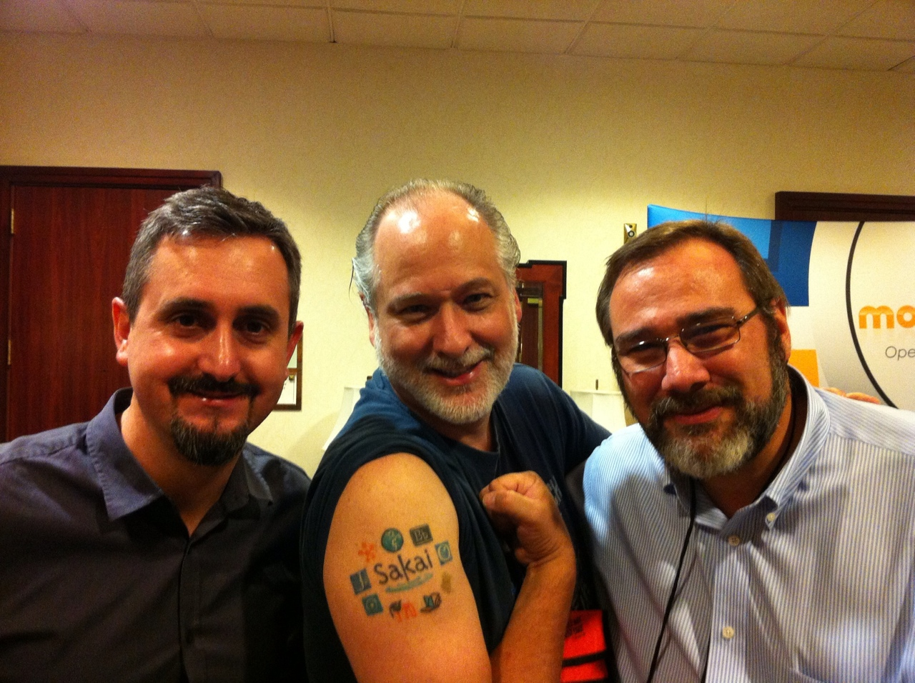

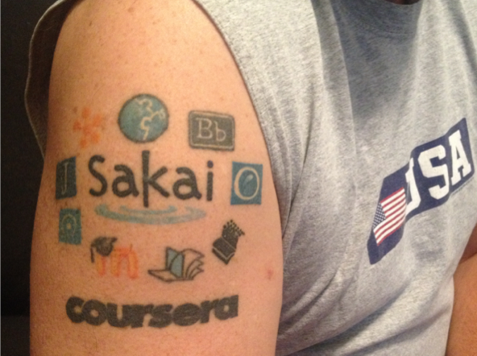
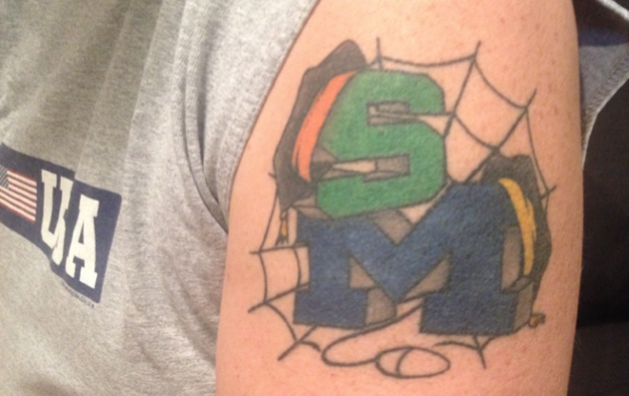
http://etherpad.dr-chuck.com/

Slide 3
10+ Years of Effort...
http://etherpad.dr-chuck.com/

Slide 4
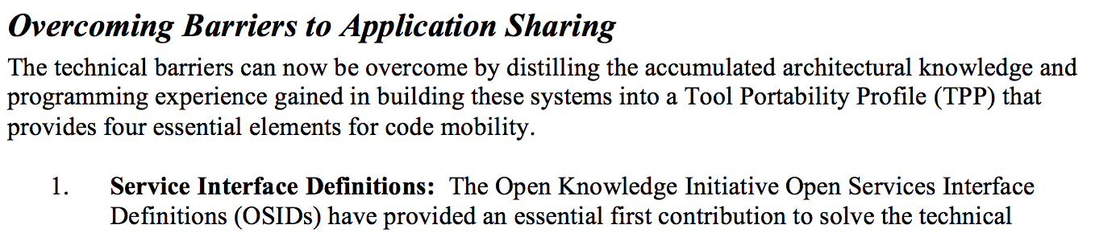
From the 2003 Sakai Proposal
http://www-personal.umich.edu/~csev/papers/2004/2004_03_01_mellon_sakai_proposal.pdf

Slide 5

Summer 2004 – Tools Interoperability
A way for Sakai and Blackboard to meet on neutral ground under the auspices of IMS
Met in Denver
Bob Alcorn, Blackboard
Chris Vento, WebCT
Chuck Severance, Sakai
TI design based on WebCT PowerLinks

Slide 6
By July 2005 - Demonstrate
December 12, 2004
Welcome to CLE 1
Welcome to CLE 2
Welcome to CLE 3
Button
Button
Button
Button
Button
Button
External
Application
Button Button Button Button Button Button Button Button
External
Application
External
Application
Button Button Button Button Button Button Button Button
CLE 1
CLE 2
CLE 3
External
Application

Slide 7
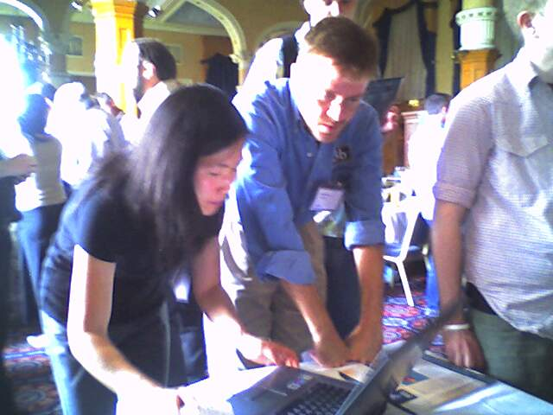
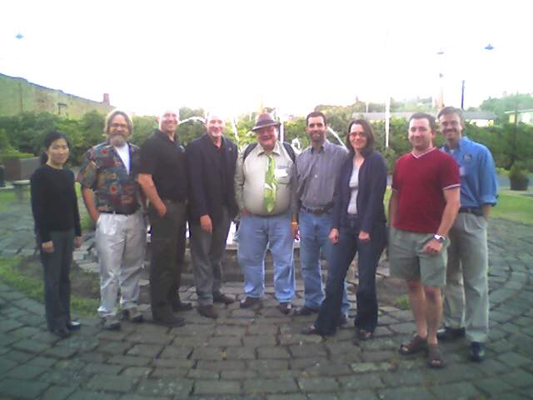
TI 1.0 - 2005
Sheffield England April 2005
Blackboard, WebCT, Sakai, Moodle, Samigo
Had grade return

Slide 8
Tools Interoperability 1.0 #fail
TI 1.0 used SOAP protocols in 2006
Crickets....

Slide 9
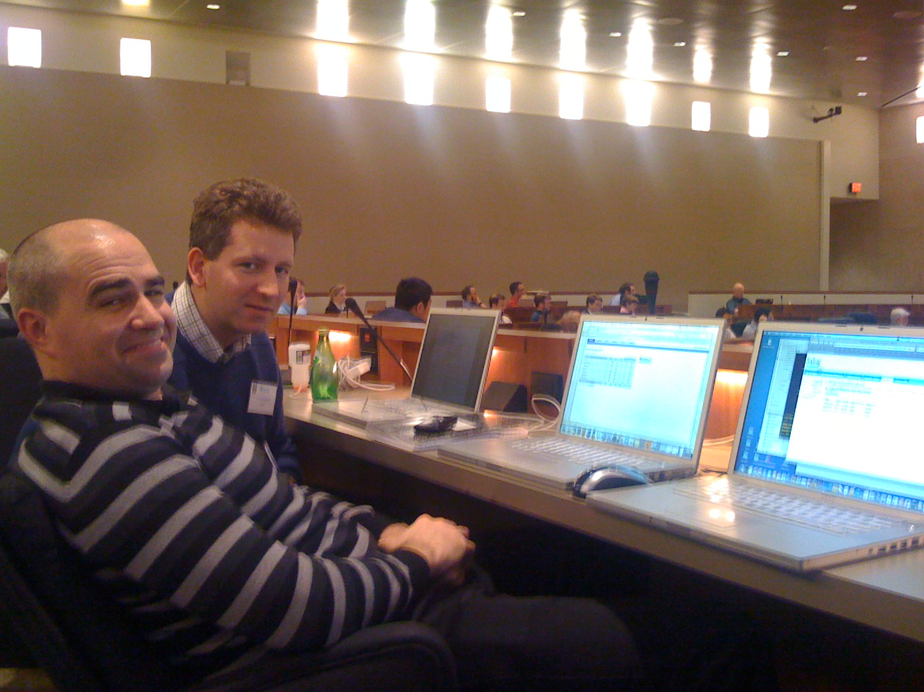
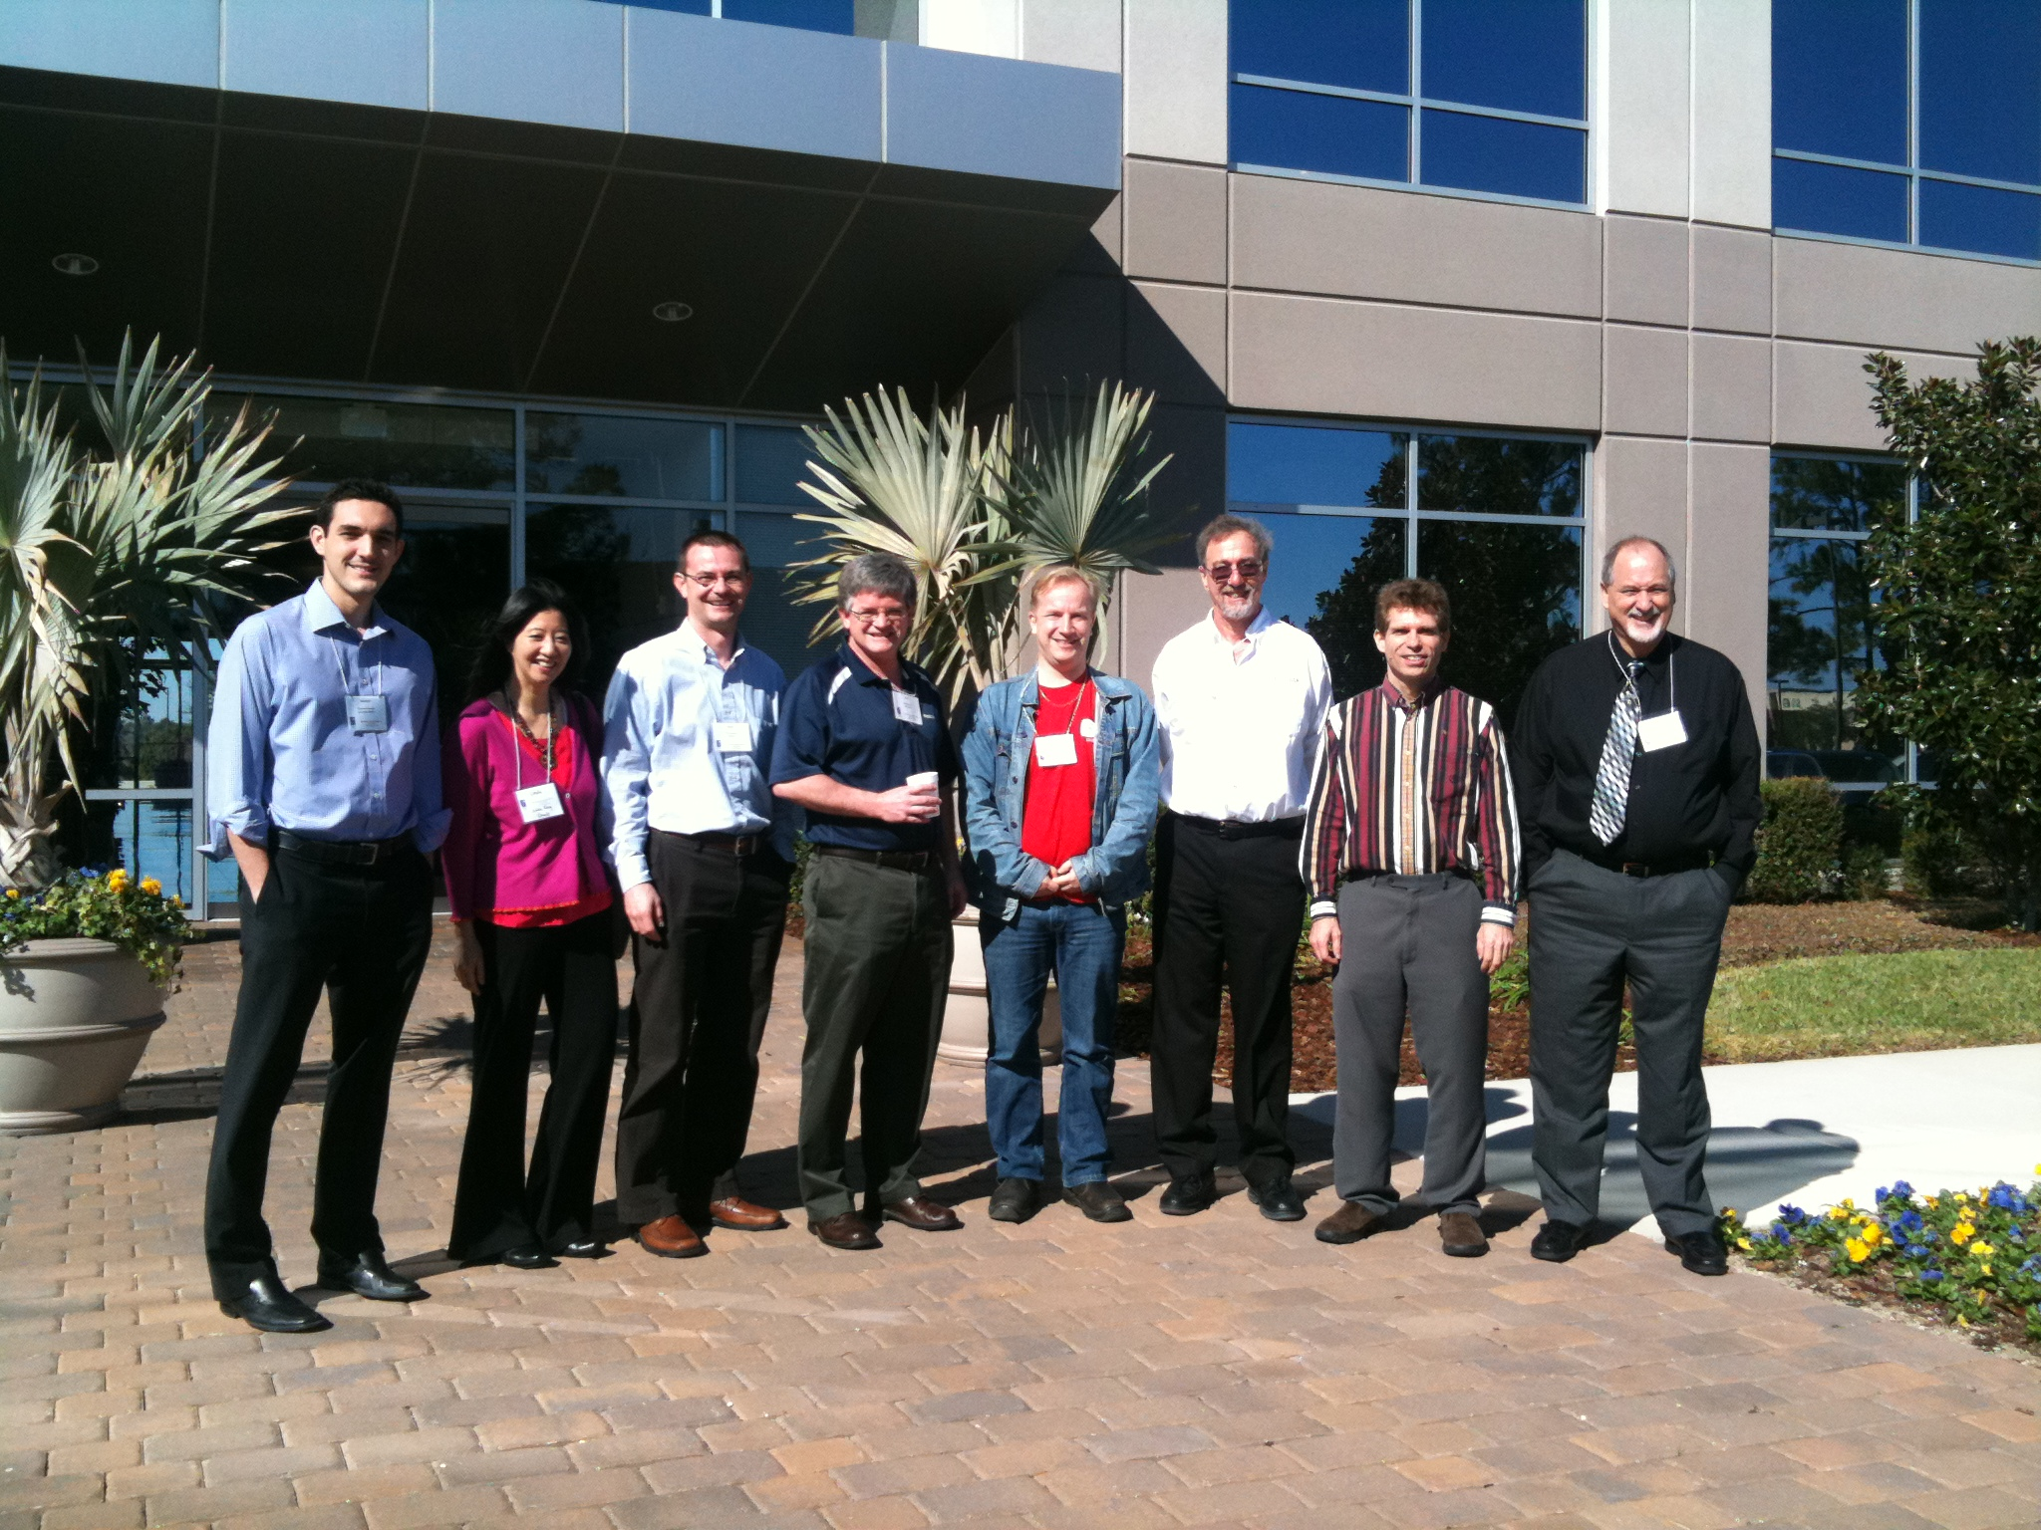
Learning Tools Interoperability
Lets start over (2007)
RESTish – POX actually
POST data in, XML out
Modeled on Wimba's Integration API
As easy as the Facebook API!
Bruno Van Haetsdaele
Wimba
Chris Moffatt Microsoft

Slide 10
Blackboard 9.0 Proxy API
By the end of 2007 we were building reference implantations for "Wimba-LTI"
Blackboard separately had built their BB9 Proxy remote "building block"
We saw it and decided to realign LTI with BB9 Proxy in early 2008

Slide 11
Viral Evangelism
March 2008, I had a Google Summer of Code in-flight for Sakai and Moodle
So I invented a non-specification that was a bit of Wimba and a bit of Blackboard - I called it Simple LTI and promised it would be "temporary"
Marc Alier (Moodle committer) made the "Dinosaur Video"
http://www.vimeo.com/7825070

Slide 12
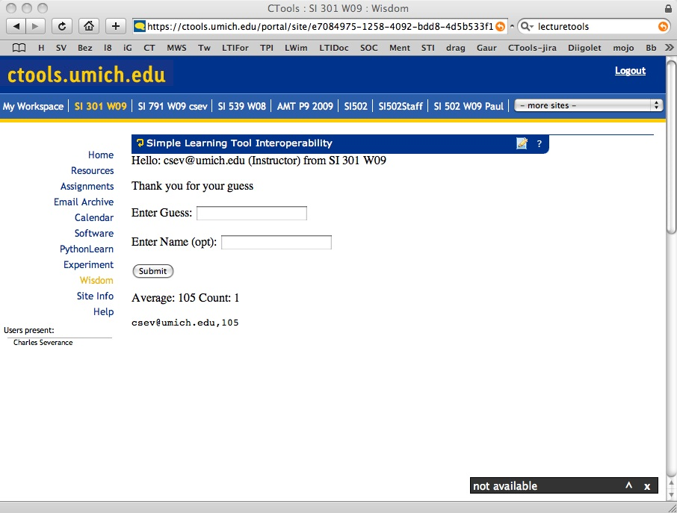
B
R
O
W
S
E
R
L
M
S
T
O
O
L
CLICK
WEB SVC
SIMPLE
LTI LAUNCH
(2008)
AUTO
POST
IDENTITY, COURSE, ORG, SIGNATURE
SESSION
COOKIE
CLICK

Slide 13
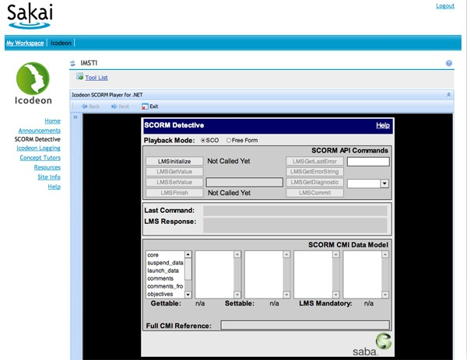
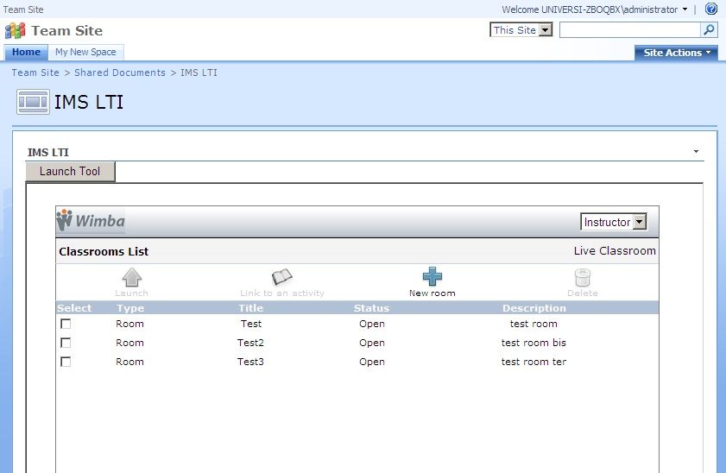
Educause 2008

Slide 14
LTI + BB9 Proxy Meet Pearson's TPI
Pearson became interested and brought its TPI forward
We found OAuth
REST + JSON
We start over (again)
Lance Neumann
Blackboard
Greg McFall Pearson

Slide 15
Basic LTI (LTI 1.0)
With LTI looking like it would take a long time, we needed a stop gap
We extracted the launch protocol from the (large) LTI draft and moved it forward
A POST of form data using OAuth 1.0
Completed and released as LTI 1.0 May 2010

Slide 16
LTI 1.1 (Simple Outcomes)
We quickly added the ability to have a grade book row associated with a launch and a web service to set, retrieve, and delete that single grade
We used XML + OAuth Body Hashing
Released (March 2012)
Desire2Learn was the first major LMS

Slide 17
<?xml version = "1.0" encoding = "UTF-8"?>
<imsx_POXEnvelopeRequest
xmlns="http://www.imsglobal.org/services/ltiv1p1/xsd/imsoms_v1p0">
<imsx_POXHeader>
<imsx_POXRequestHeaderInfo>
<imsx_version>V1.0</imsx_version>
<imsx_messageIdentifier>541c3492bf376</imsx_messageIdentifier>
</imsx_POXRequestHeaderInfo>
</imsx_POXHeader>
<imsx_POXBody>
<replaceResultRequest>
<resultRecord>
<sourcedGUID>
<sourcedId>81e0a730cf9b60ffacbf:::content:22</sourcedId>
</sourcedGUID>
<result>
<resultScore>
<language>en-us</language>
<textString>0.7</textString>
</resultScore>
</result>
</resultRecord>
</replaceResultRequest>
</imsx_POXBody>
</imsx_POXEnvelopeRequest>

Slide 18
Tool Consumer
Tool Provider
Tool
Profile
lis_result_sourcedid
Profile
Tool Proxy Runtime
replaceResult
Tool Proxy
Tool
readResult
Secret
Secret
deleteResult
TC
Admin
TP
Admin

Slide 19
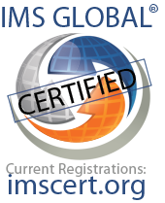
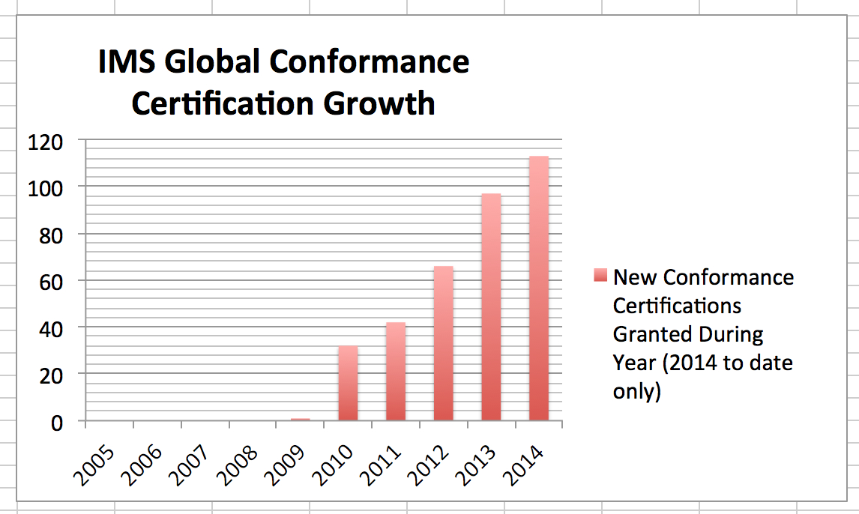
SIMPLE LTI
TI 1.0
LTI 1.0
LTI 1.1
LTI 2.0

Slide 20
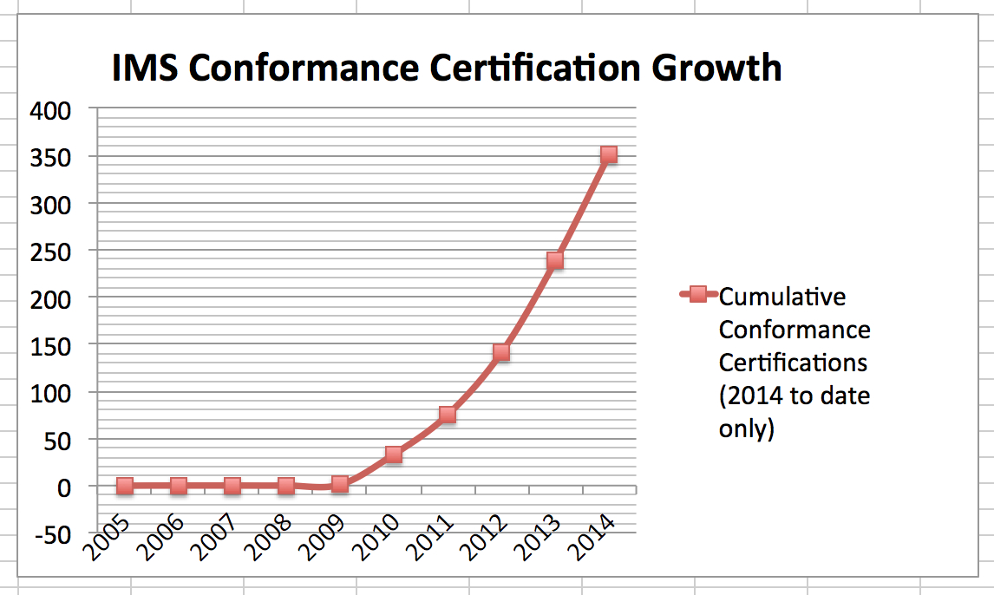

Slide 21

































Learning Platforms that Accept IMS Apps! http://imscatalog.org/
Notes:
ROB
Does LTI provide real evidence that there can be a single approach for integrating with multiple software platforms?
Yes, over 20 learning platforms accept LTI apps – and growing.
In addition, there are now over 100 certified LTI applications !!!
In fact there were close to 100 new certifications in 2013 alone.

Slide 23
Exercise 2
http://etherpad.dr-chuck.com/

Slide 24
LTI 2.0

Slide 25
Basic LTI and Full LTI
"LTI" was making great progress in 2009
Great design from BB9 Proxy and Pearson TPI
Lots and lots of specs – massive scope
Lance Neumann
Blackboard
Greg McFall Pearson

Slide 26
Release Early and Often...
Basic LTI was a copy of the LTI launch spec
Tons of stuff removed
Developed in parallel in the same working group
Not allowed to diverge
Basic LTI became LTI 1.0 at the moment of release

Slide 27
LTI 1.1 – Grade Return
We needed a grade return API and did not want to use SOAP like TI 1.0
We in the process of working through issues around validating JSON for certification
So a "Plain Old XML" with OAuth body hashing was used
This divergedfrom Full LTI (now LTI 2.0)

Slide 28
<?xml version = "1.0" encoding = "UTF-8"?>
<imsx_POXEnvelopeRequest
xmlns="http://www.imsglobal.org/services/ltiv1p1/xsd/imsoms_v1p0">
<imsx_POXHeader>
<imsx_POXRequestHeaderInfo>
<imsx_version>V1.0</imsx_version>
<imsx_messageIdentifier>541c3492bf376</imsx_messageIdentifier>
</imsx_POXRequestHeaderInfo>
</imsx_POXHeader>
<imsx_POXBody>
<replaceResultRequest>
<resultRecord>
<sourcedGUID>
<sourcedId>81e0a730cf9b60ffacbf:::content:22</sourcedId>
</sourcedGUID>
<result>
<resultScore>
<language>en-us</language>
<textString>0.94</textString>
</resultScore>
</result>
</resultRecord>
</replaceResultRequest>
</imsx_POXBody>
</imsx_POXEnvelopeRequest>
{
"@context":"http://purl.imsglobal.org/ctx/lis/v2/Result",
"@type":"Result",
"comment":"Howdy",
"resultScore":{
"@type":"decimal",
"@value":"0.94"
}
}

Slide 29
"Full LTI" Becomes LTI 2.0
To ship LTI 2.0 we left out a lot of "Full LTI"
Launch (compatible with LTI 1.0)
Tool Registration via web services
Outcomes in JSON
Settings Service
JSON-LD – JSON for Linked Data
REST3

Slide 30
JSON-LD – www.json-ld.org
RDF / Linked-Data meets Hacker-Friendly JSON
Depending on the application, you can look at it as a collection of linked triples or just a clean serialization of a REST-Style resource

Slide 31
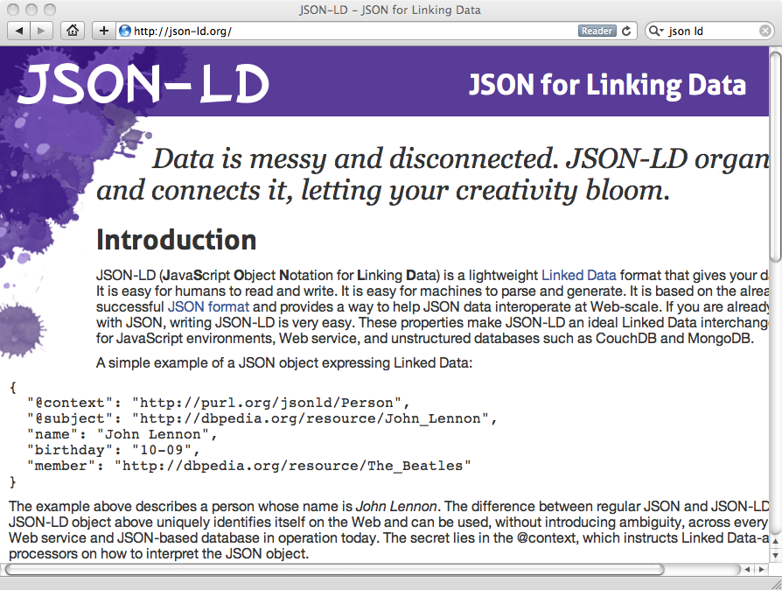

Slide 32
LTI 2.0 (Final, January 2014)
REST/JSON architecture
Registration process:
profiles to share capabilities and available services
agree key and secret
Tool settings and Result services
Certified:
Vital Source (Tool Provider)
Sakai 10 (Tool Consumer)

Slide 33

LTI 2.0 Tool Registration
Tool
1. Tool registration
2. Request TC Profile
Tool Provider
3. Send Tool Proxy
5. Service requests
Tool
Tool
System Administrator
4. Enable tool(s)
Admin
7. Launch request (context, user, role)
Tool Consumer
Course
6. Click link
Teacher or Student
Key
Browser connection
Server-to-server connection

Slide 35
Exercise 3 – Explore LTI 2.0
http://etherpad.dr-chuck.com/

Slide 36
Sample code: LTI 2
Ruby on Rails (John Tibbetts, Vitalsource):
https://github.com/vitalsource/LTI2-Reference
video: https://www.youtube.com/watch?v=3zTbtTldeiA
Java, Sakai 10:
http://nightly2.sakaiproject.org:8081/portal
video: http://www.youtube.com/watch?v=-Dt2Sz5ilLQ
PHP, Sakai unit tests:
https://source.sakaiproject.org/svn/basiclti/trunk/basiclti-docs/resources/docs/sakai-api-test
https://online.dr-chuck.com/sakai-api-test/

Slide 37
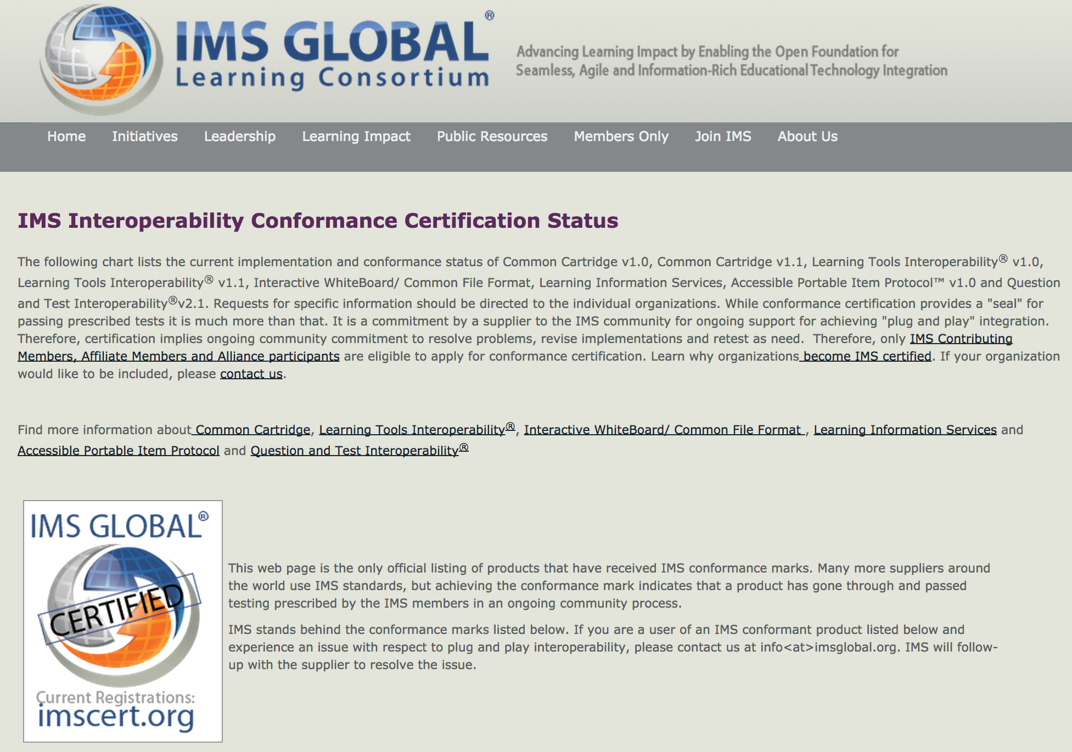
www.imscert.org

Slide 38
LTI 2.x Roadmap
LTI 2.0 was reduced in scope to registration, launch, outcomes and settings
LTI 2.1, 2.2... Will come pretty rapidly
Roster API
Rich Outcome support
Common Catrtridge
....

Slide 39
Reflecting...

Slide 40
LTI 1.x versus LTI 2.x and Beyond
LTI 1.x – Three pages of spec and some "hello world" code
LTI 2.x – Several specs – multiple interactions
We will need to share common implementations across instructions
And what about Caliper, Casa, xAPI, etc. ??

Slide 41







"Large Midwestern University"
Sakai
.......
Looks pretty cool.... But...

Slide 42
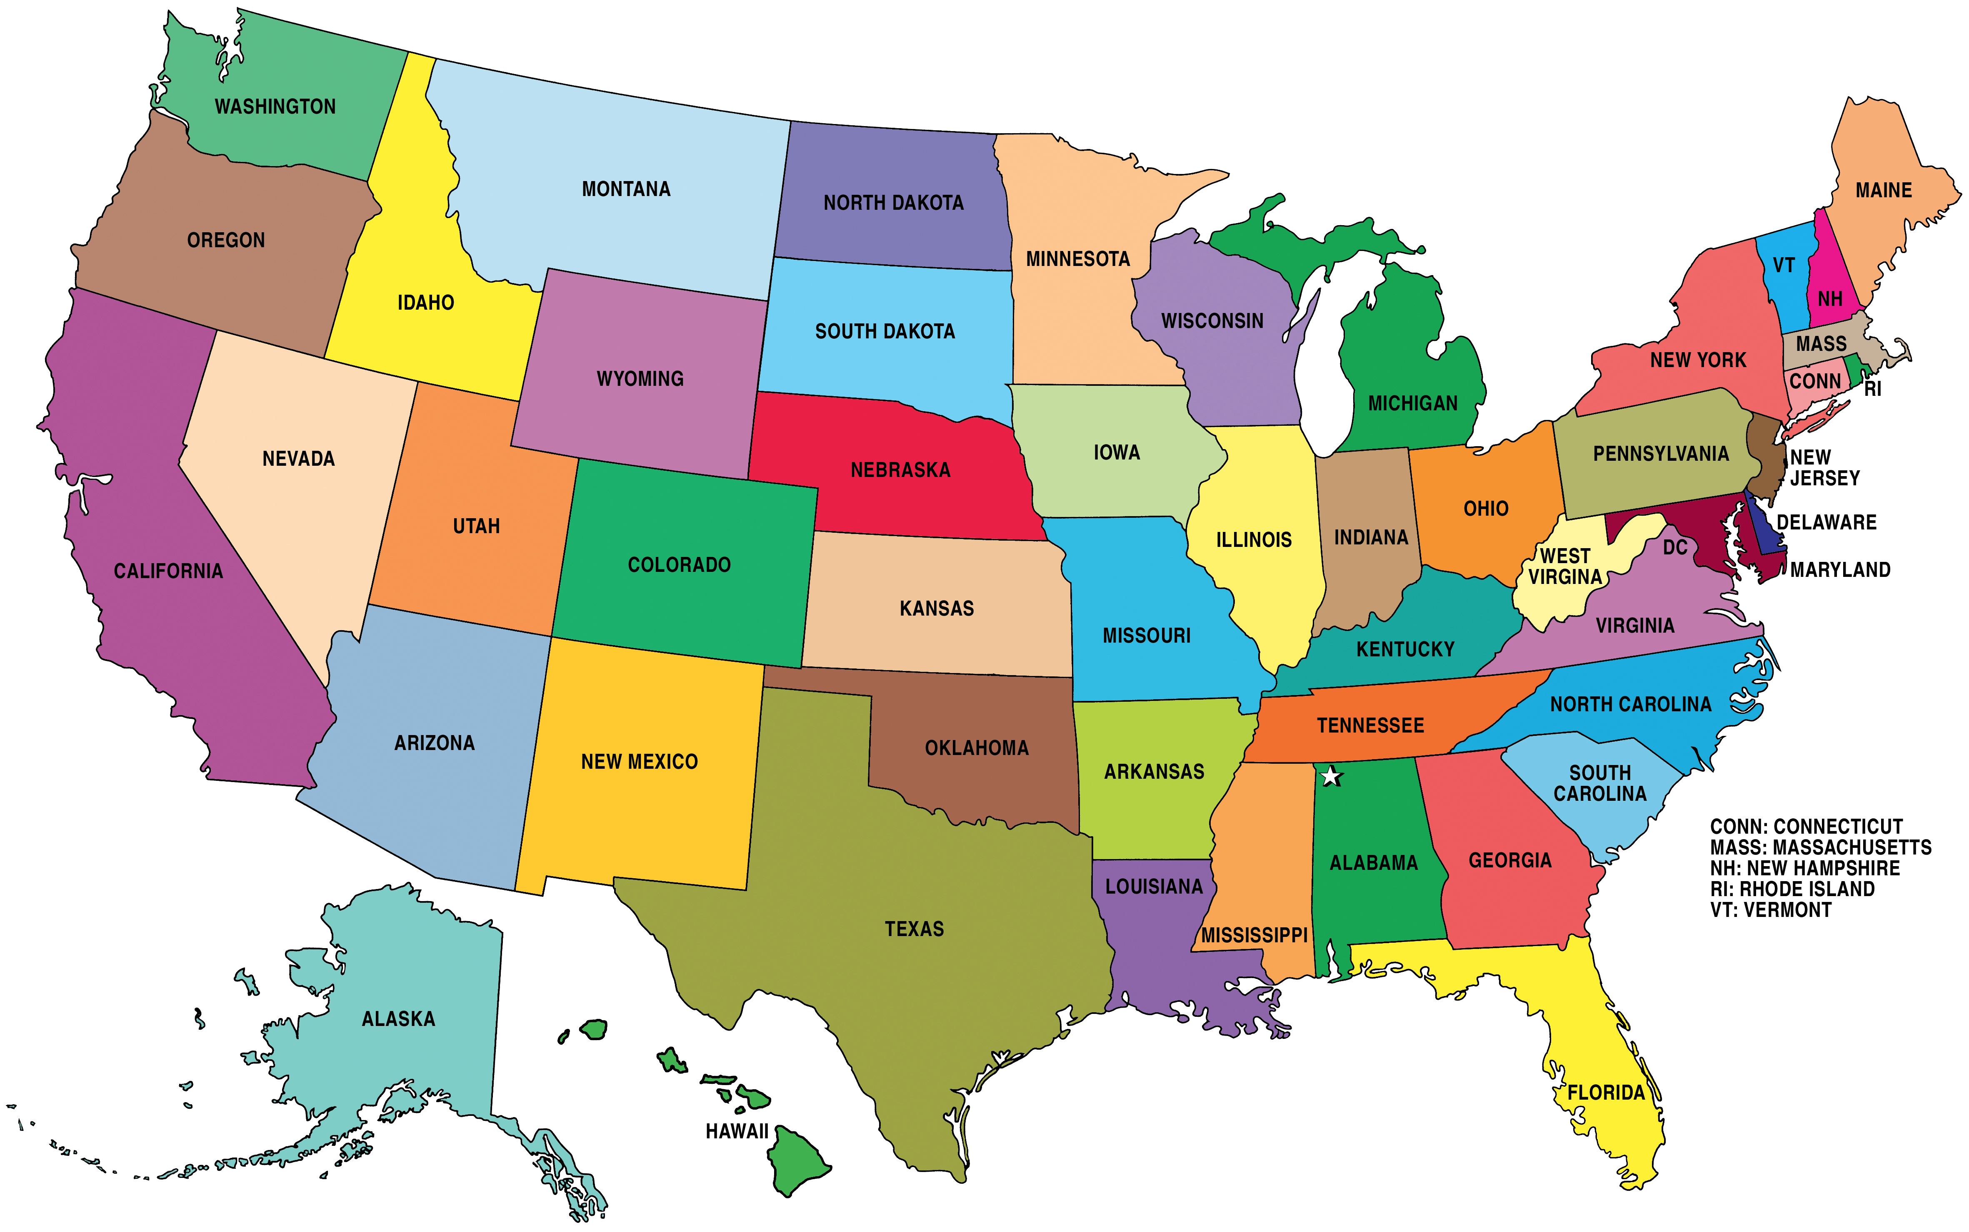
Sakai
Where is the user data??
What happens when there are 50 apps?
What if the app is free and hosted by a professor?
What happens if we stop paying the license?

Slide 43
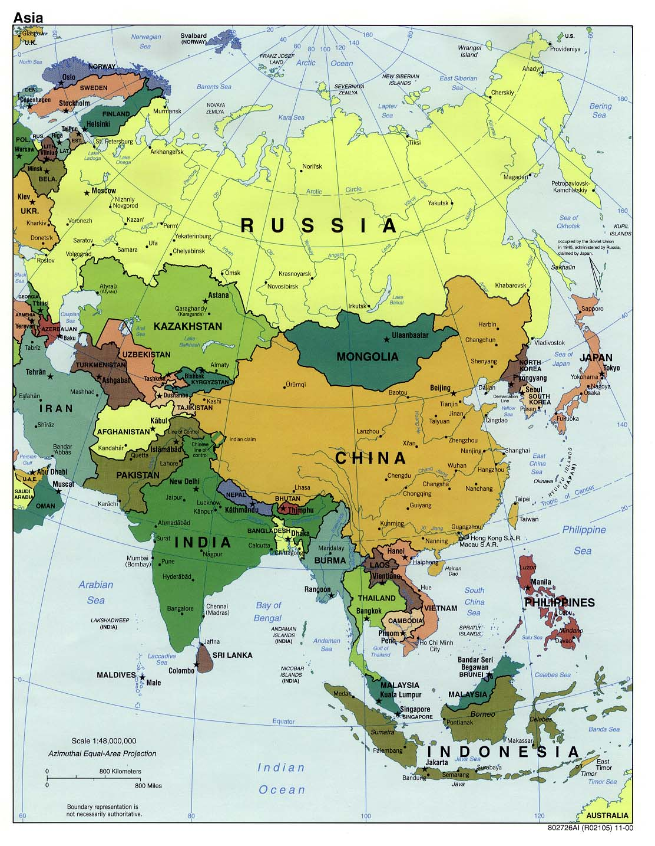
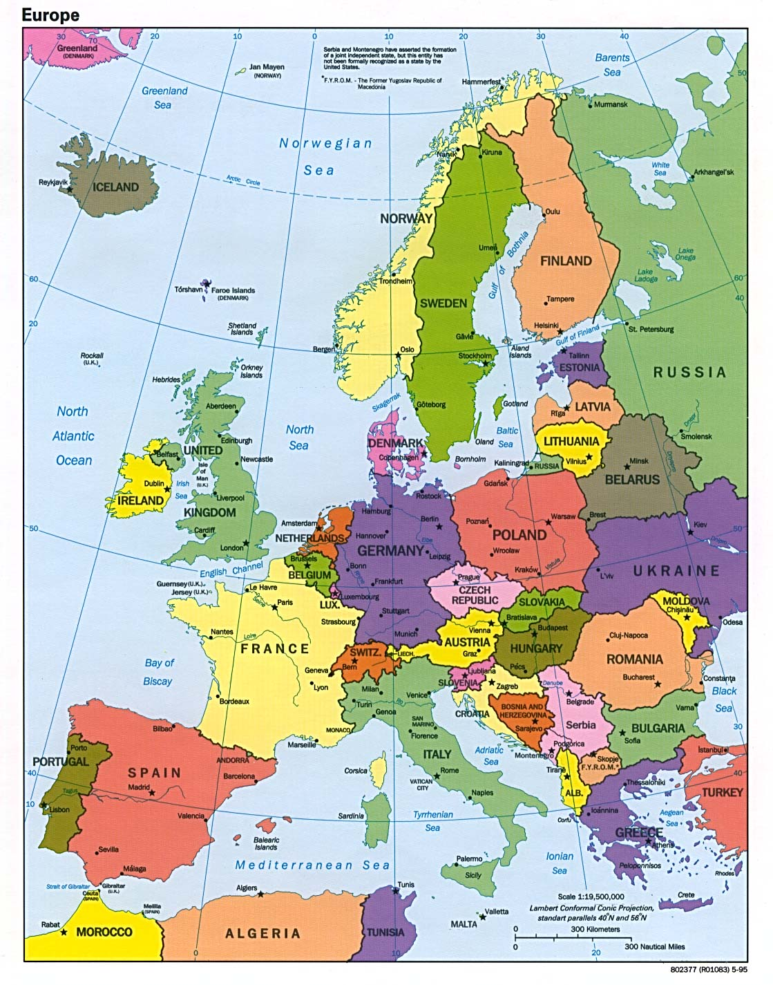
Neo-Colonialism
LTI-style

Slide 44

App
Store
Tool
Tool
Tool
Tool
...

Slide 45
Hosting
Container
Tool
Tool
Tool
Install
App
Store
Tool
Tool
Tool
Tool
...

Slide 46
Hosting
Prod
Hosting
Exp
Tool
Tool
Tool
App
Store
Tool
Tool
Tool
Tool
...

Slide 47
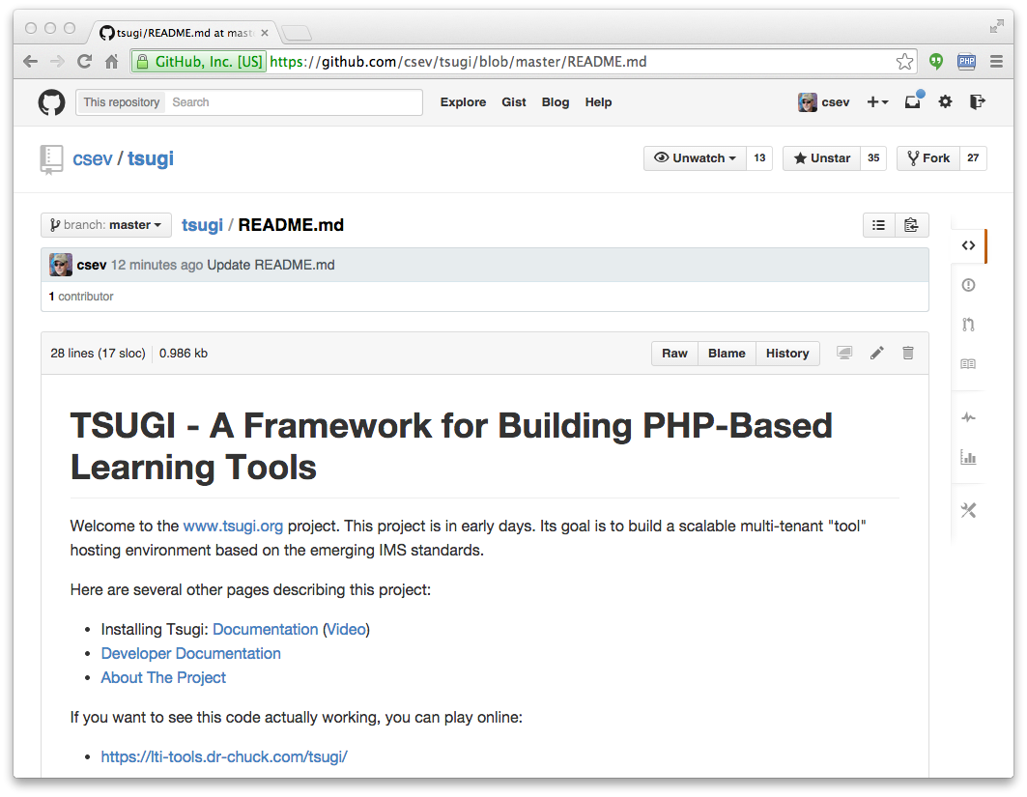
www.tsugi.org

Slide 48
PHP Tsugi
Install / Configuration similar to Moodle
Emulate the Moodle APIs / Runtime
Multi-tenant
Cookie free (i.e. loves iframes)
Uses PDO with some rules about FK
Auto-ddl feature to upgrade schema

